Slide 1
智能系统设计与应用 (2022 春季学期)
A Simple Case：
Quasi-Real Time
Background Fading in
Mobile Video Chat Applications
主讲教师：詹德川

Slide 2
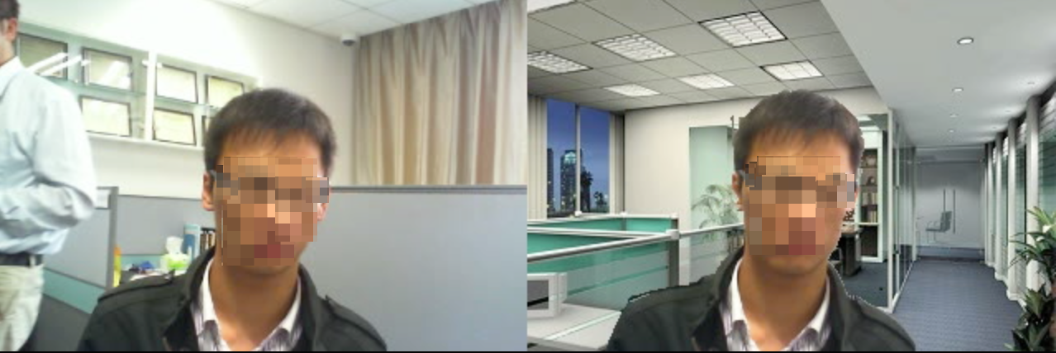
Application and Targets
Application:
An example on background fading and substitution in a video conferencing. The moving person in the background is removed and replaced by a stationary background in the right picture.
Project Source: BST/三星电子中国研究院
Project Details:
Front Camera on Samsung Phones or Mobile Devices
Project started on 2013
Technique Route is Restricted to Machine Learing
So generally can be attributed to the Contour Tracking Area

Slide 3






What if no restrictions?
Basic Tricks of A Photographer:
Flash and mirrors
lights
then How about the video background fading?
Flashing every 40ms?
(In 2013, Samsung has deployed the OLED screen already)
Local smooting of Alpha Matting

Slide 4



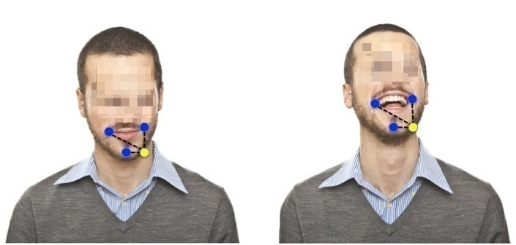
OK, We are chosen for Machine Learning
So what is the problem?— We need to model the talking face....
However,
In mobile security video phone calls, when the participator is talking, the entire foreground is changing non-rigidly
Fortunately,
we can still treat the foreground’s shape and texture as rigid in localities since the relative position of each part, i.e., the facial features and shoulder, are kept in general
The movements of facial parts are non-rigid. However, the relationship between contour points (e.g., the yellow dot is a contour point on the chin) and inner points on foreground (e.g., the blue points around the mouth) can be kept

Slide 5
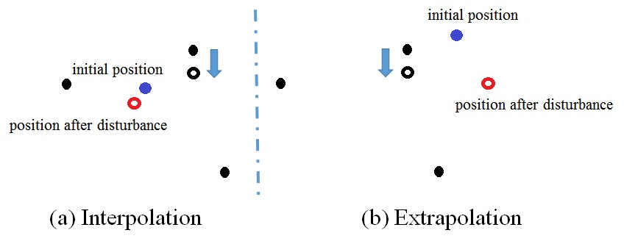
So, what is the next?
The initial position of the contour points
The methodology of representing contour points with inner points
The choice of inner points
Not all inner points are informative for representing contours
Not all inner points are suitable for tracking while you’re talking
Difference between Interpolation and Extrapolation

Slide 6
Extrapolation, always

Slide 7
Restrictive Linear Extrapolation
To find the Good Inner Points:
Not all inner points are informative for representing contours
Selected from ....
Not all inner points are suitable for tracking while you’re talking
Investigated by many literatures, relatively mature
Suppose there are n inner points can be tracked well
The object contour are represented by m contour points
Interpolation reconstruction:

Slide 8
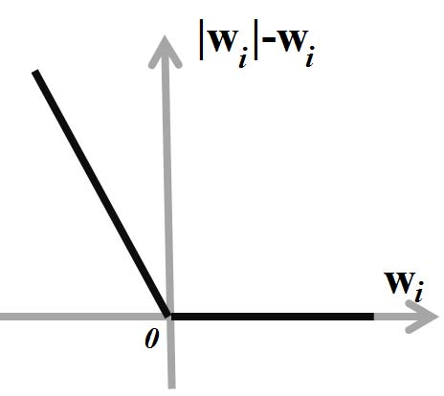
Restrictive Linear Extrapolation
However, when x_{i} are contour points, the interpolation cannot return an appropriate output, since contour points are not in the convex hull of v
w can be larger than 1 or less than 0 in Extrapolation
Assumption or intuition: the value of w_{i} goes extreme, the performance of Extrapolation cannot be guaranteed, so….
Very similar to hinge loss
Not compact!

Slide 9
Restrictive Linear Extrapolation
Yet not so compact☺
dividing the coeffificients w into a subtraction form of two positive components, i.e., w = w⁺ −w⁻, where
So we have
Typical QP

Slide 10
Selecting Good Features for Reconstruction
Not all inner points are informative for representing contours
Not all inner points are suitable for tracking while you’re talking
Reconstruction with More inner points yields more running time costs
it is necessary to select the inner points which are “easy” to track as well as “good” for facilitating the reconstruction

Slide 11

Why?
Differences occurs when $w^{+} = w^{−}> 0$
Both of the situations are satisfied the constraints
Both of the reglarization terms are forcing $w^{+} = w^{−}−> 0$

Slide 12
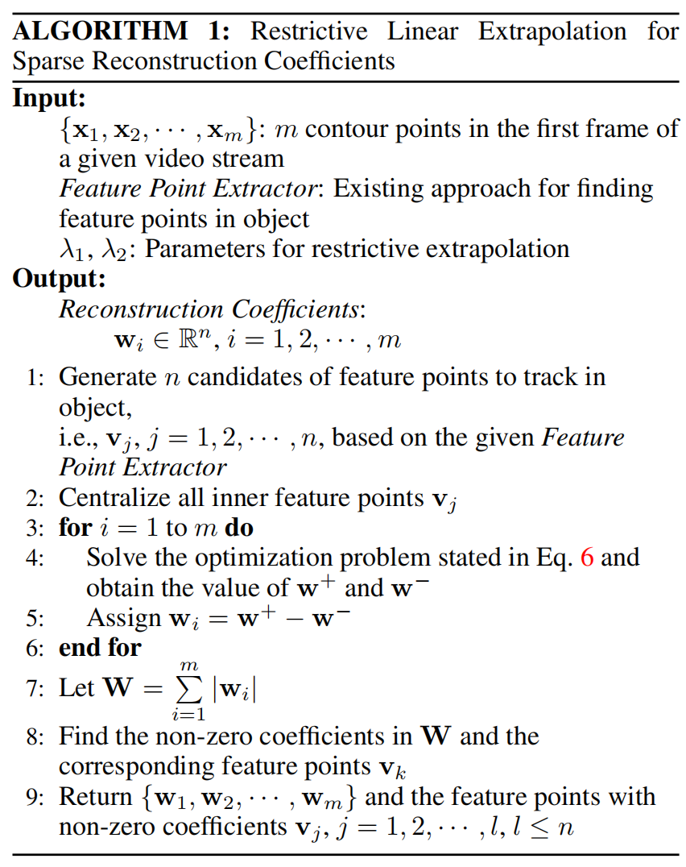
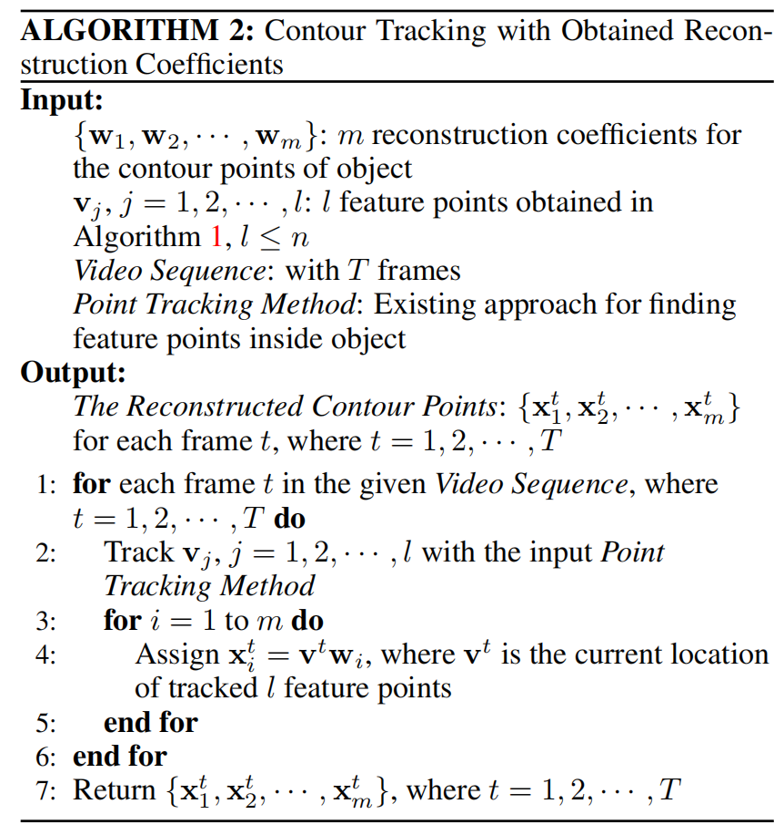
Methodology

Slide 13
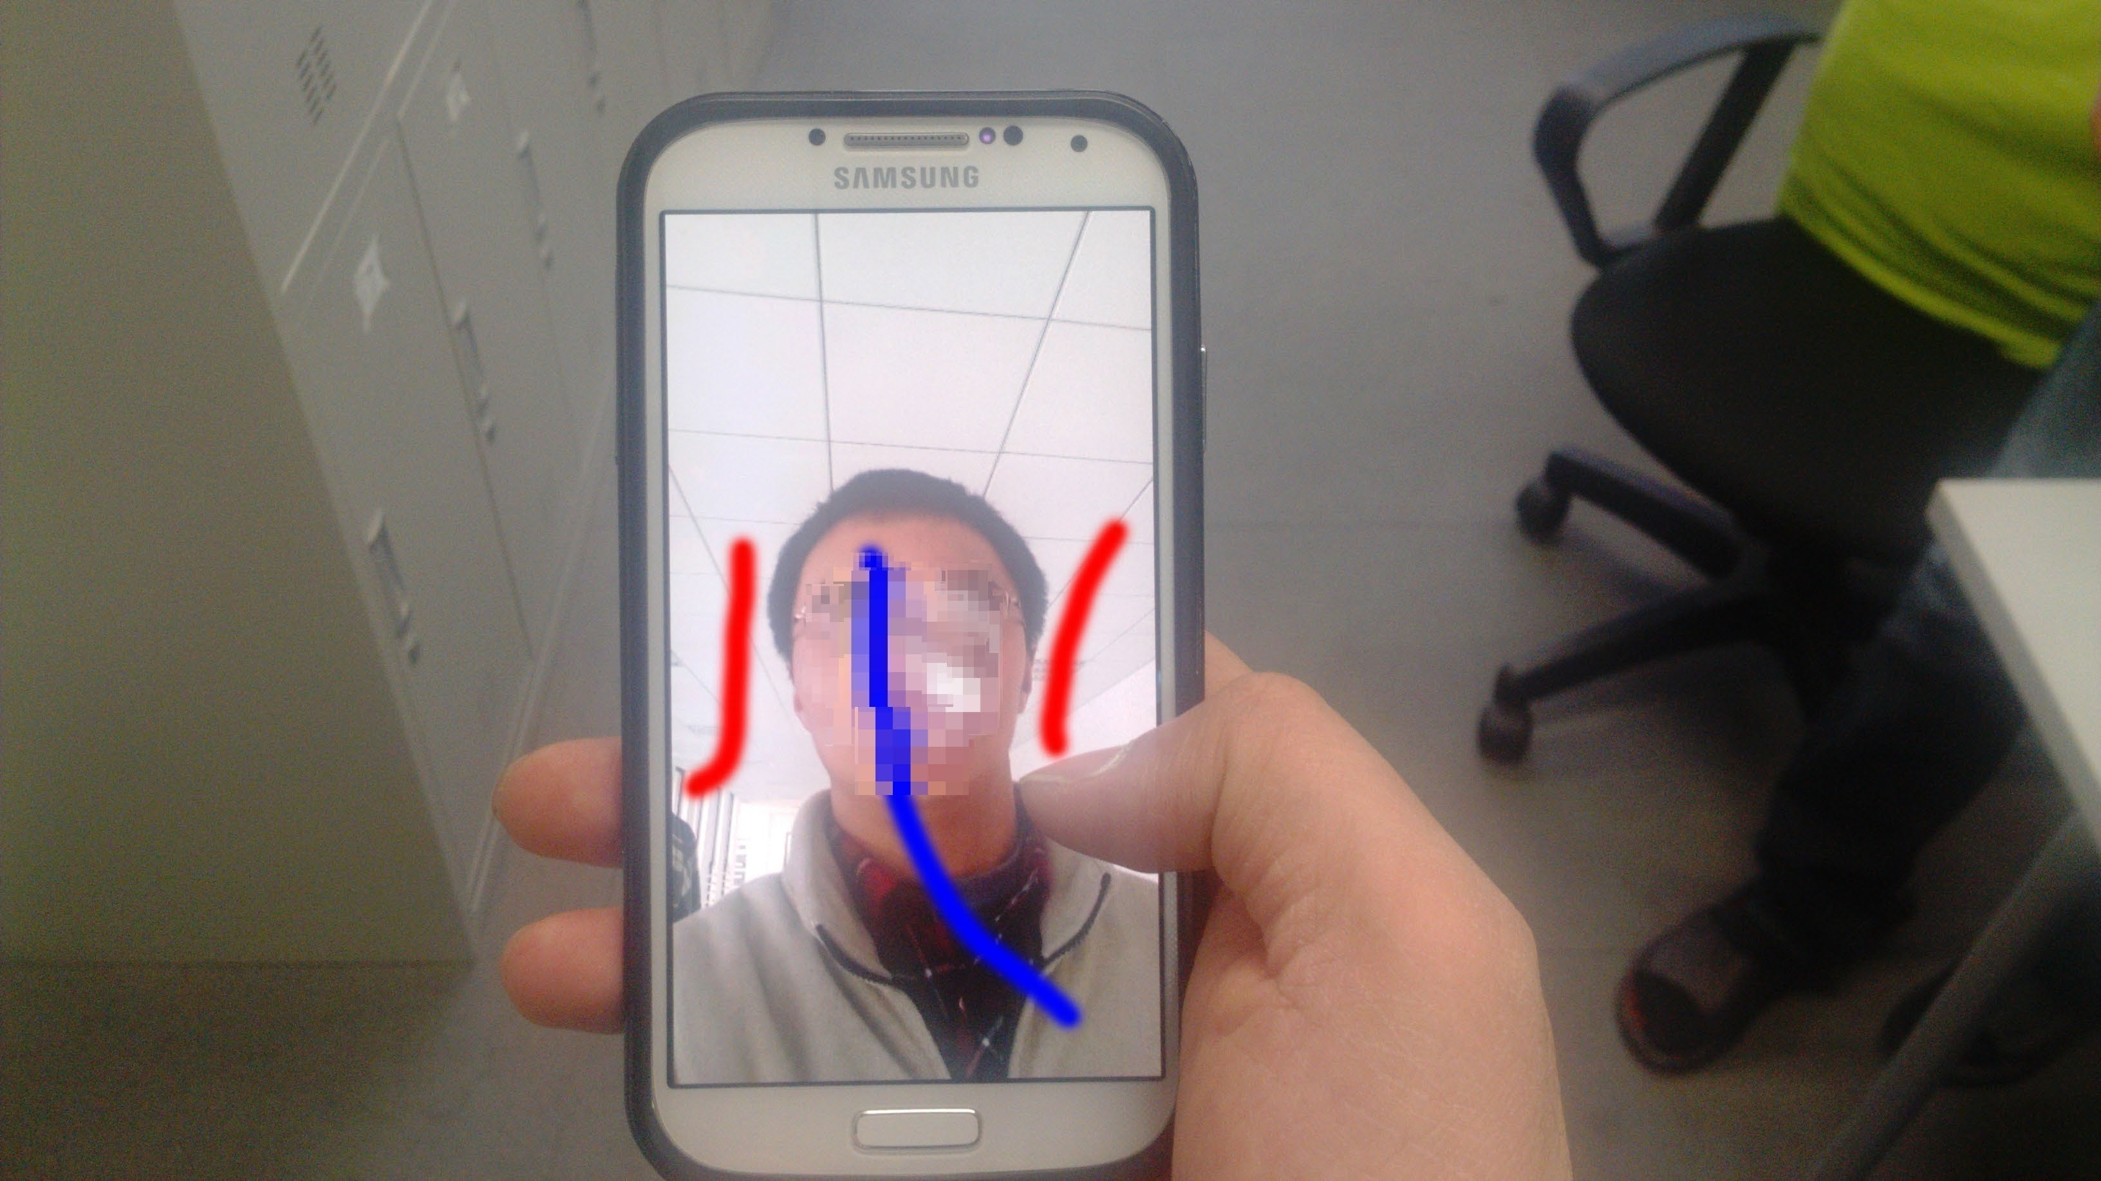
System Design
Approaches require the contour points in the 1st frame of a given video steam as an input
How to form a smooth and natural boundary on head-shoulder contour in different pre-defined backgrounds remains unsolved
Grabcut

Slide 14
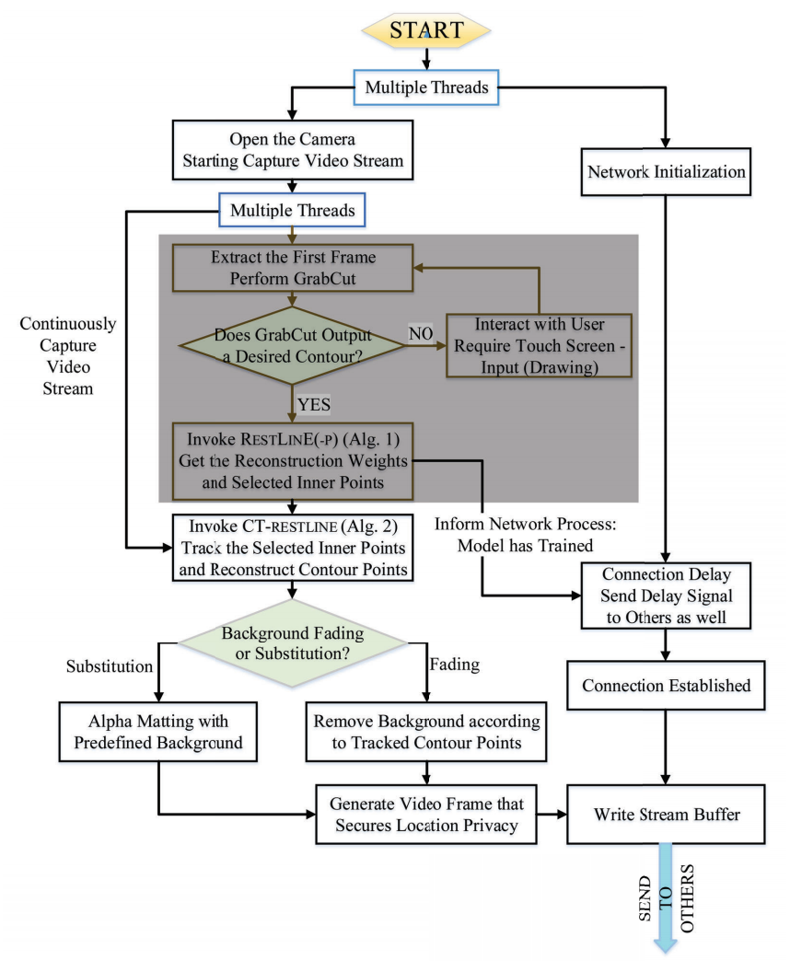
Workflow chart

Slide 15
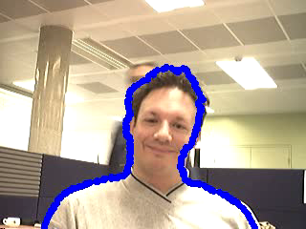

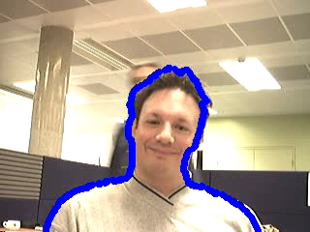


Experiment results
traditional Lucas-Knada as base bench.

Slide 16
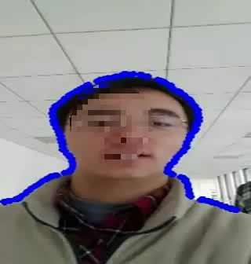
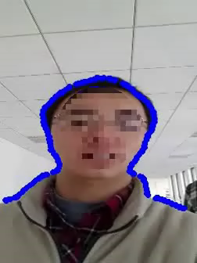

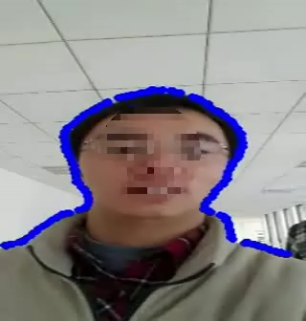
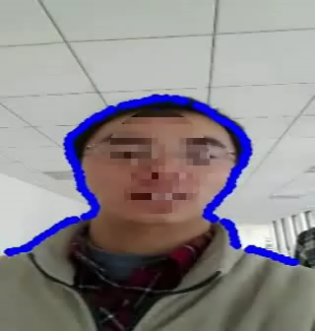
Experiment results

Slide 17
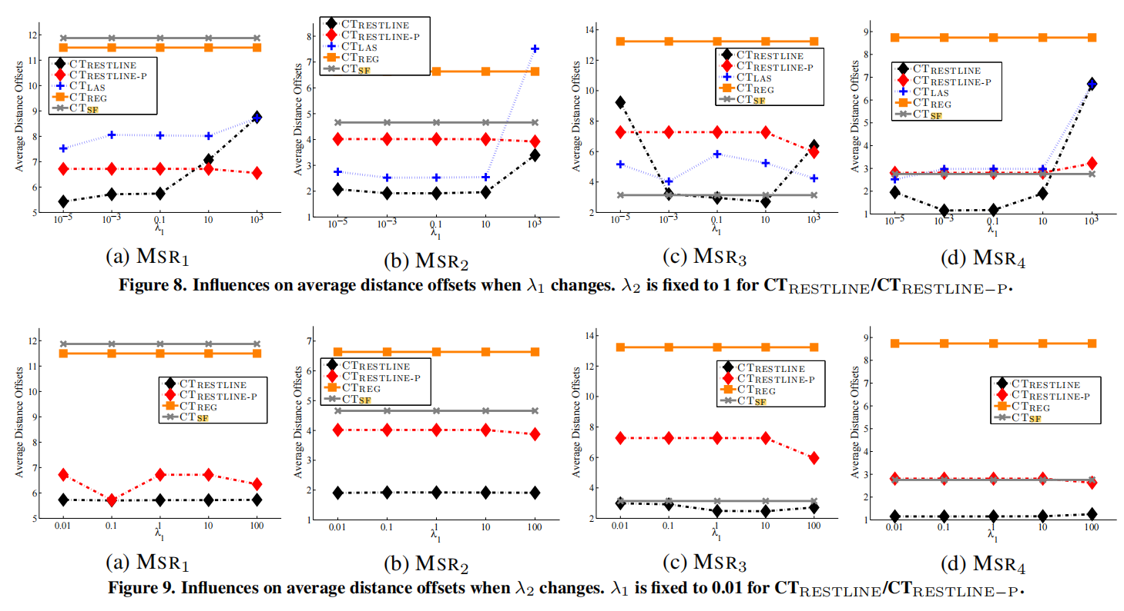
Ablation investigation

Slide 18
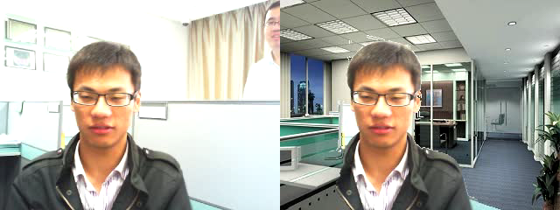
Delivery Results without Smoothing

